Slide 1
Portfolio Presentation
EDS325
By: Adrita Khan
Notes:
Hello everyone! My name is Adrita Khan and today I will be presenting to you my Portfolio!

Slide 2
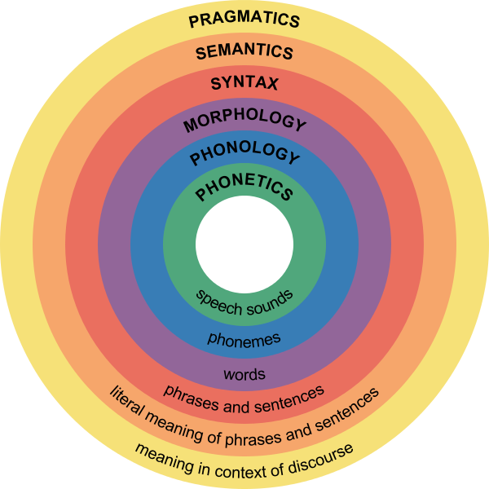
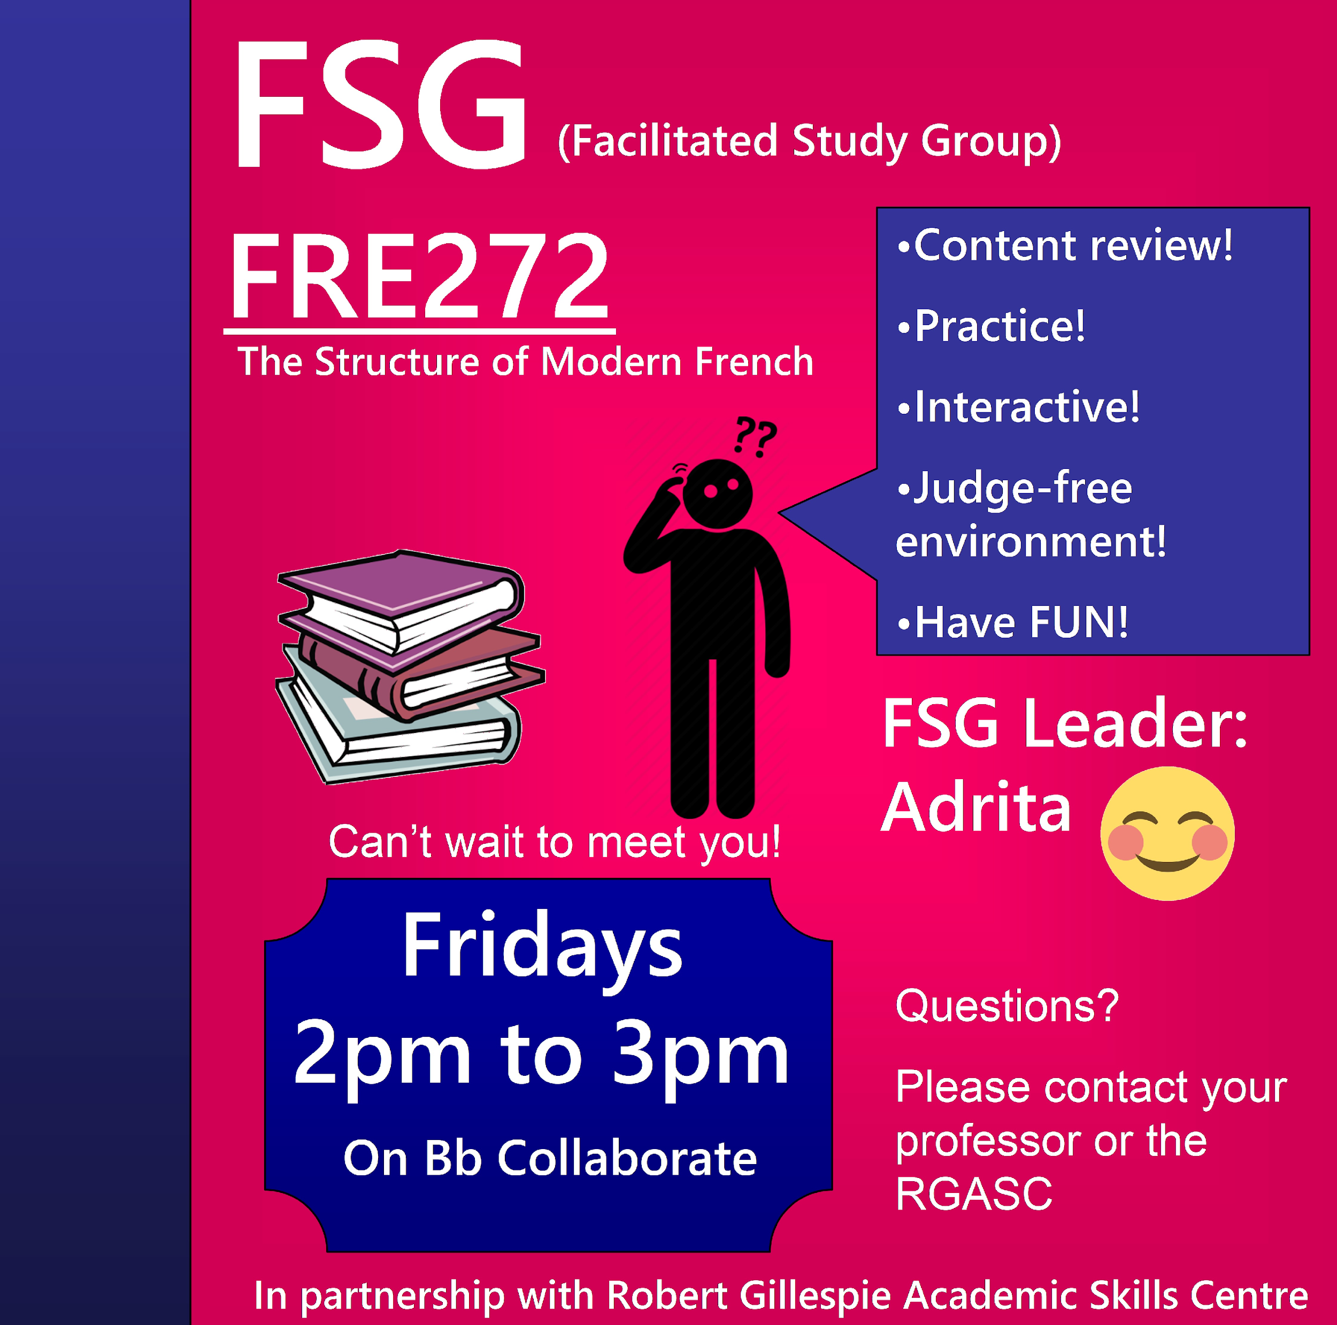
Welcome to FRE272!
Notes:
So welcome to the FRE272 French Linguistics course! In this Y course students learn about the 6 different ways how they could analyze the French language. At the beginning I used to be alone but I had an amazing co-facilitator, name Theresa. Together we ran the sessions on Fridays from 2 to 3pm but then we changed it to 3 to 4pm.

Slide 3

Ubuntu
Notes:
I’m sure many of you would agree that the article on Ubuntu was quite eye opening. I never thought of leadership as a mutual beneficence and where an individual would share a way of life with others. I learned that Ubuntu was about unifying people and building a community where we all empower each other. As a FSG leader, it was important for me to show empathy and to put myself into the students’ shoes. Also, every student should have the opportunity to express themselves to make their experience more significant and motivating. So, while making session plans we made sure to take the students’ advice into consideration.

Slide 4
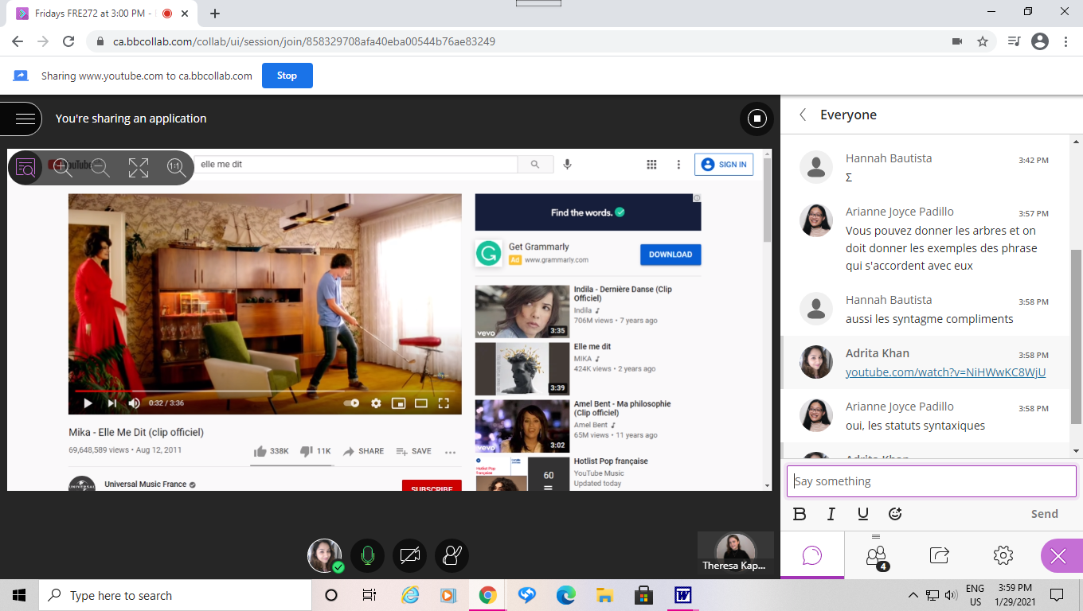
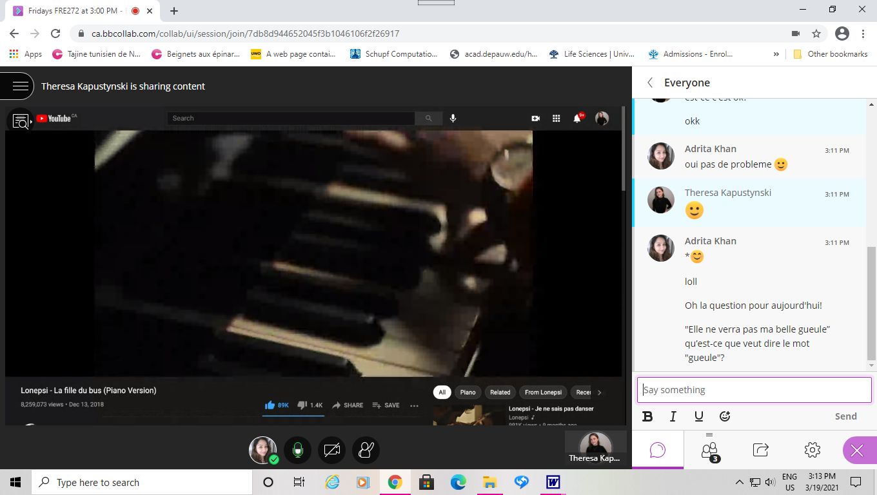
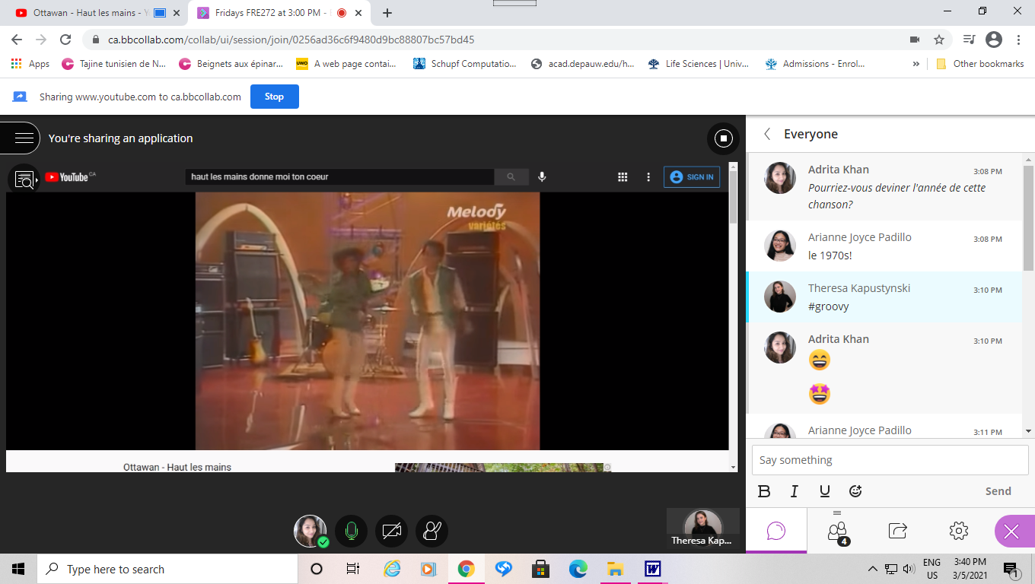
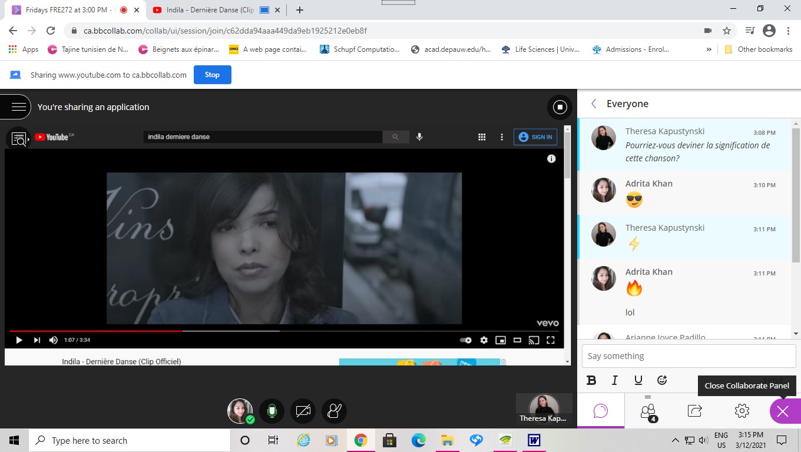
♪ A “French” Start ♬
Notes:
To create a sense of unity we always started our FSG sessions with a discussion. We asked students how they were doing and had them express their feelings by drawing on the whiteboard. But when I started to take this course, I realized that songs would be more interesting. For this reason, we played French songs and asked the students to answer a question related to it on the chat. Each week we chose different types of music from pop to disco to even rap songs.

Slide 5
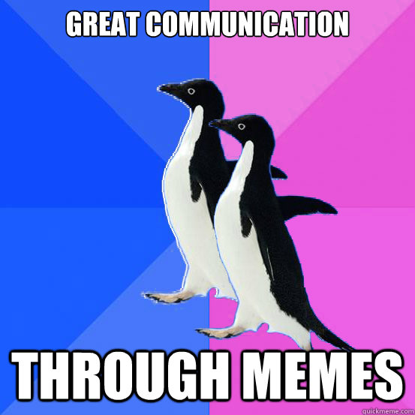
Communication is Key
Notes:
Communication is Key! From the reading “Effective communication brings successful organizational change,” I found that a sense of community, trust, participation, and taking/giving feedback made communication more effective, opening more doors to progress. I believe that sessions should be planned based on the students’ needs and reflect on their capabilities. They should feel guided and welcomed rather than worried about being judged. Our goals were to make the sessions more inclusive and to have collaboration. This made the sessions more valuable for both of us, the facilitators and the students. And this is what allowed for growth.

Slide 6
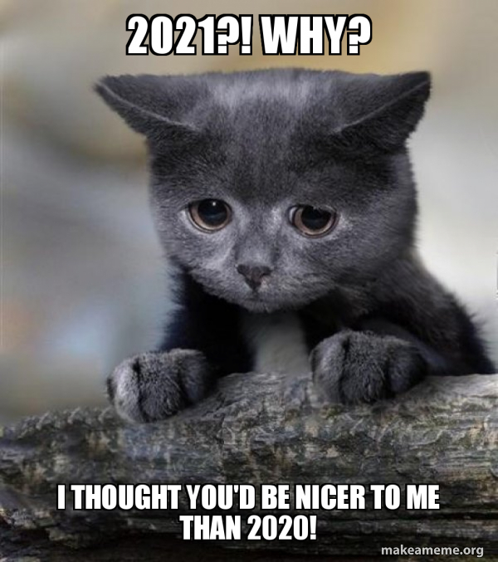
Pop Quiz!
What is this animal called in French?
Hint: A cat!
Notes:
On a scale of 1-10, as a FSG leader, how hard was it to see your students struggle or getting the wrong answers? Please put it on the chat!

Slide 7

Let’s do French Linguistics!
Un chat
ɛ̃
ʃa
Notes:
As it is mentioned in the article “Aesthetic principles for instructional design”, it is important to be outside of the story as the leader. This way, the students take the lead as the main characters and drive the plot. Because I was used to correcting students if they made a mistake, at the beginning of the FSGs it was challenging for me to see the students struggle. But then I realized that this is part of the students’ development to become independent learners and to expand on their learning skills.

Slide 8
The Plot Development
FSG Leader: Give Question
Make Progress
student
Use Skills
Success
Think
Struggle
Development
Notes:
Next, Brame and Biol mentioned the Think-Pair-Share strategy where students think individually then share their ideas with a partner and share their ideas with another pairs of students.
Because we only had 2 students, some activities were done in partners while some were done individually so they could share their ideas afterwards. So for an example, each person made the syntax trees for different sentences here. Next, they checked over each other’s work. At the end they explain their answers to us.

Slide 9
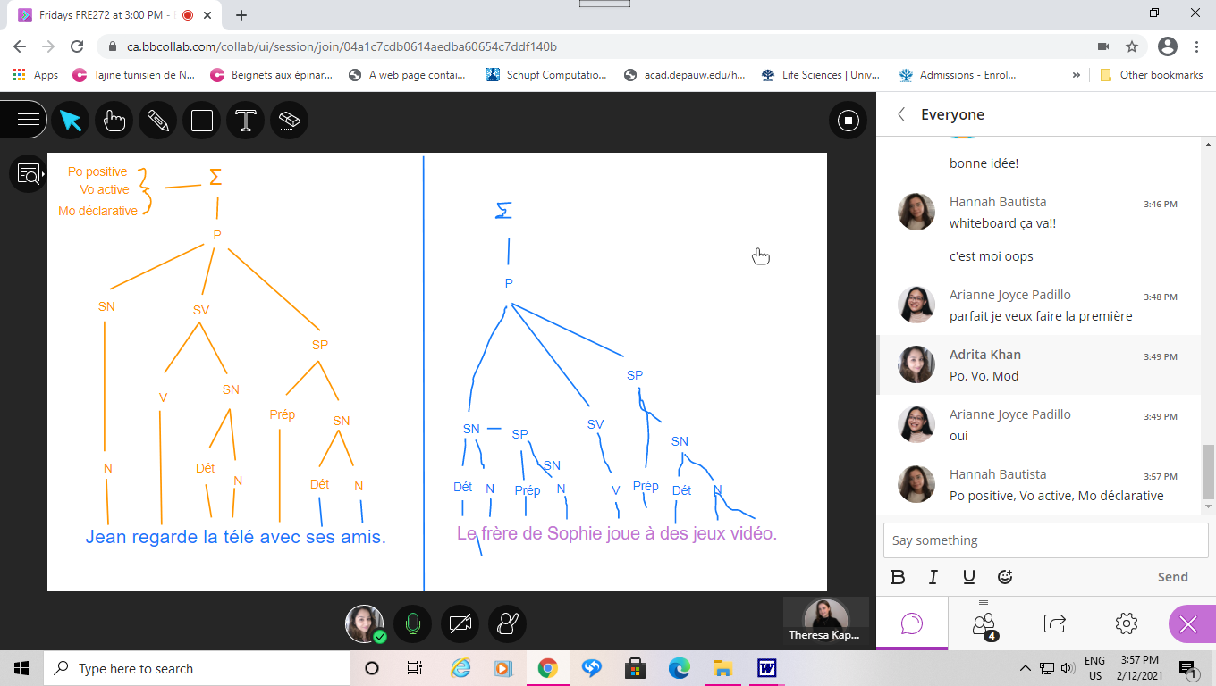
Group Work
Think-Pair-Share
Notes:
In this following example, we had them use Autodraw.com for more space. In this case you could see how the student made changes after some feedback from the other student. This way, the alpha student was able to help the shy student. Through time, the shy student learned from their mistakes and became confident about their work.

Slide 10
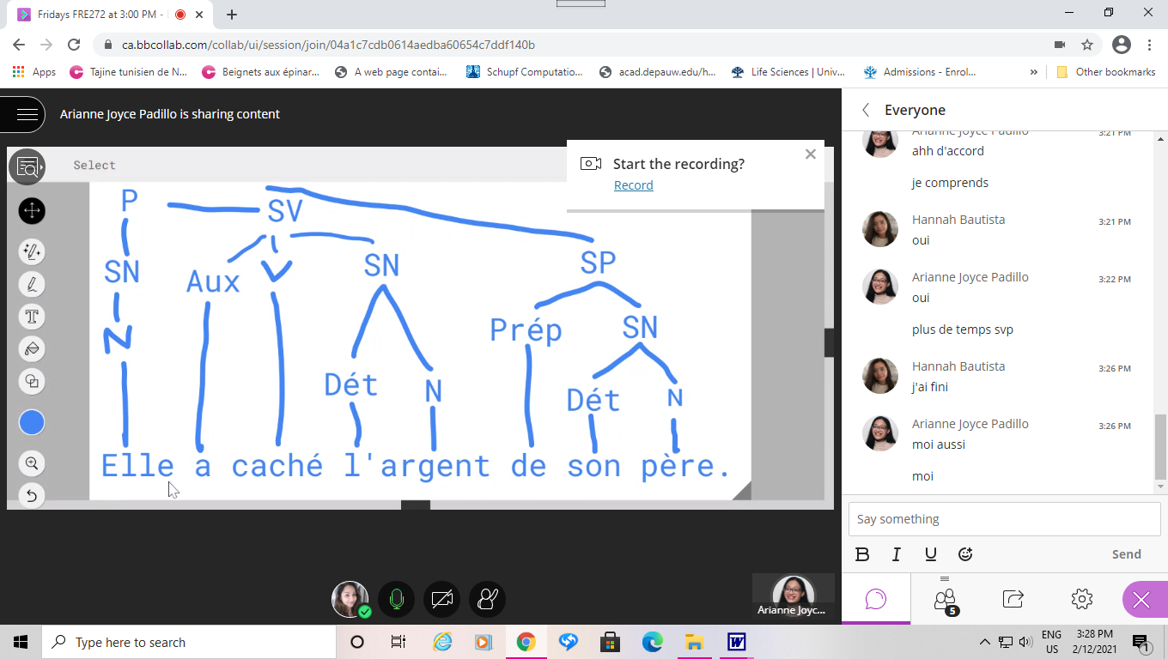
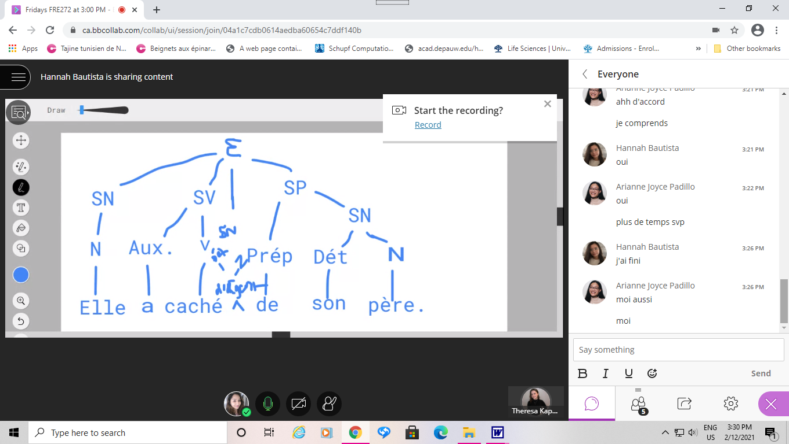
Autodraw.com
Notes:
Challenges. Sometimes we only had one student. In these moments, it was very important to make the student feel comfortable, especially if they were shy. We made sure to have an engaging discussion and reassured the student to take their time so they do not feel lonely or hesitant.

Slide 11
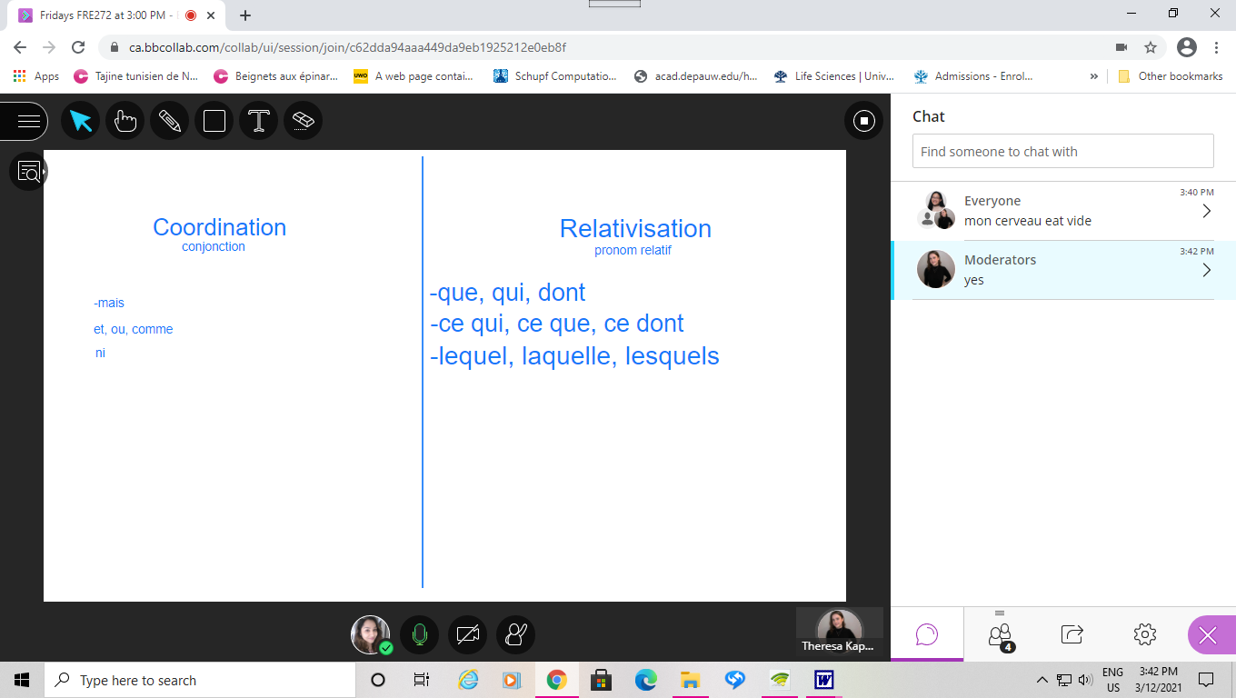
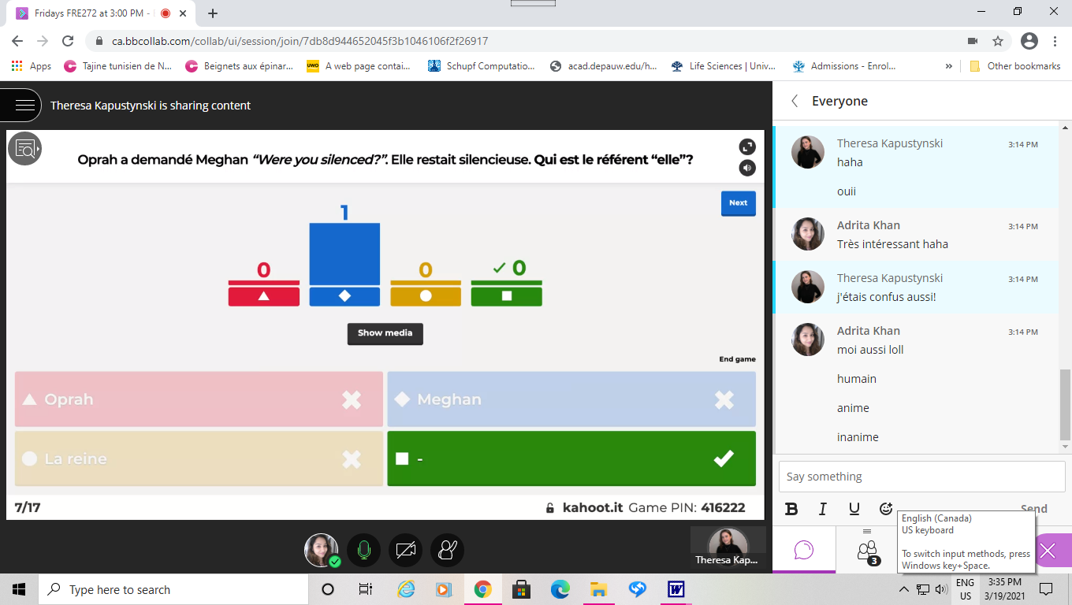
Challenges
Not participating
Less attendees
Notes:
Also, if students made many mistakes or did not understand a certain concept; we encouraged them to review their notes and textbook. If students weren’t participating, we either worded the question differently, or gave them guiding questions. But if the concepts were too difficult or new, we stopped our planned activity and had them compare the key terms using the definitions or examples.

Slide 12
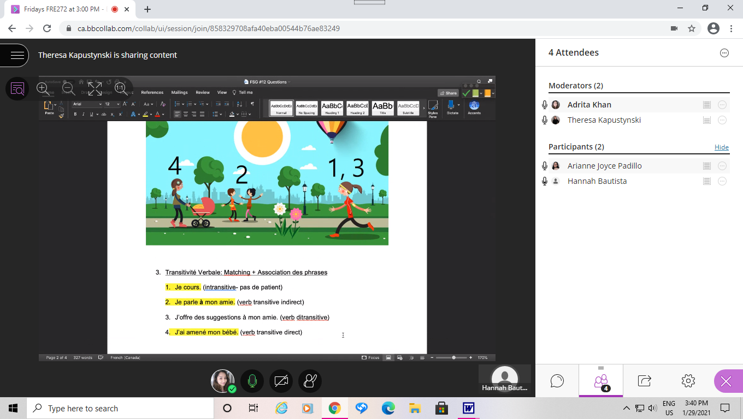
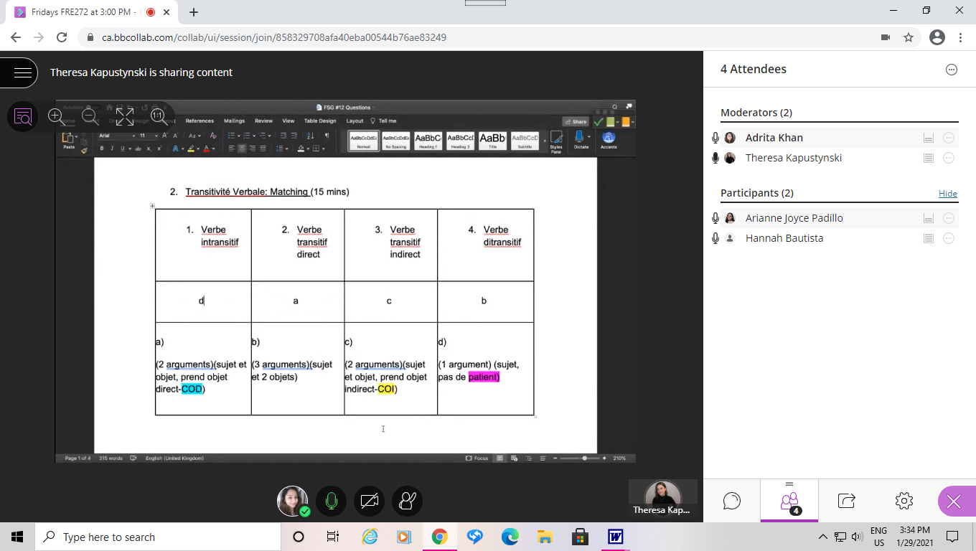
What worked well?
Word Documents
Notes:
What worked well? Microsoft Word was mostly used for definition and matching questions.

Slide 13
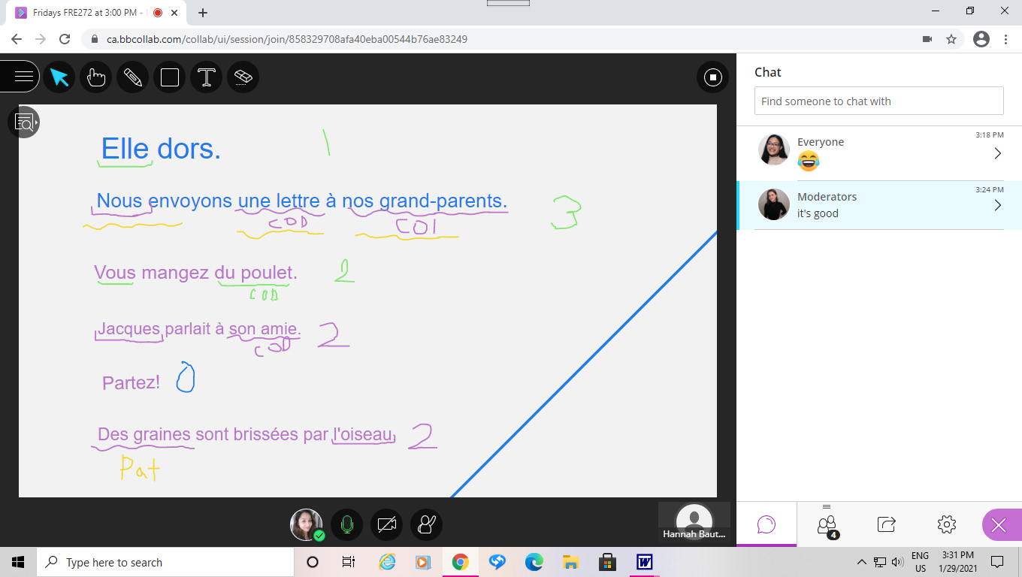
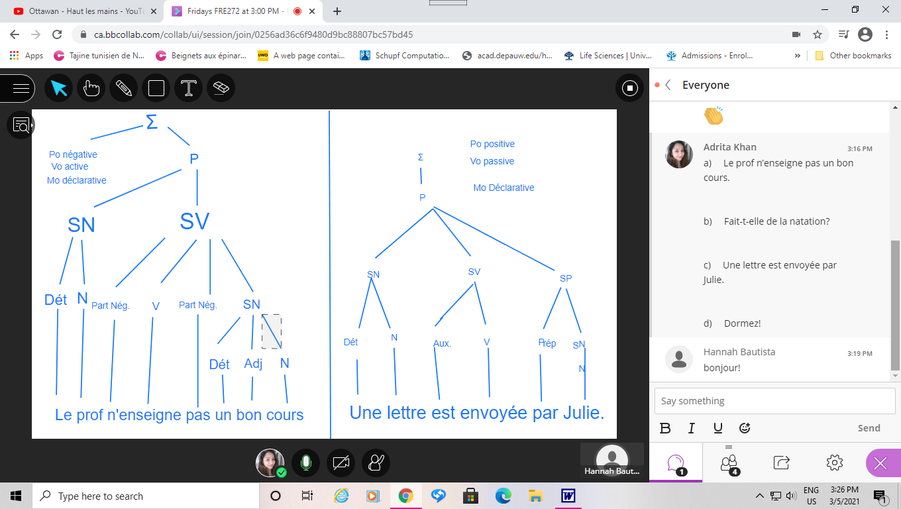
Whiteboard/Autodraw.com
Notes:
We also used the whiteboard and Autodraw.com for more space.

Slide 14
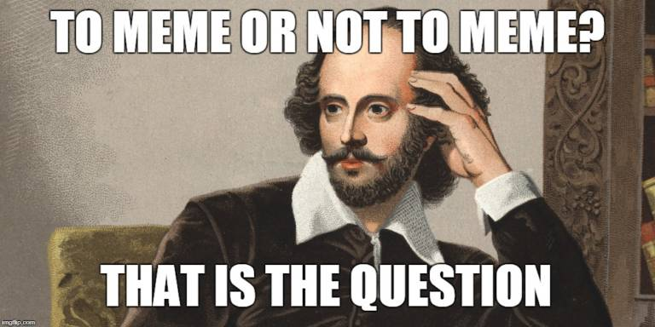
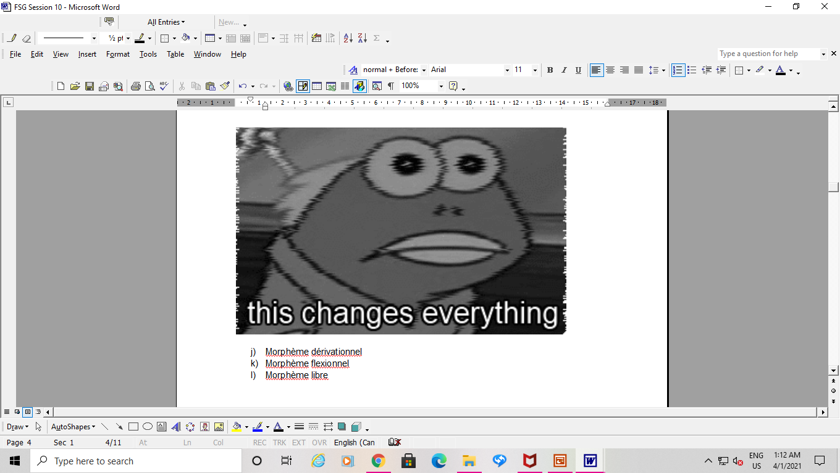
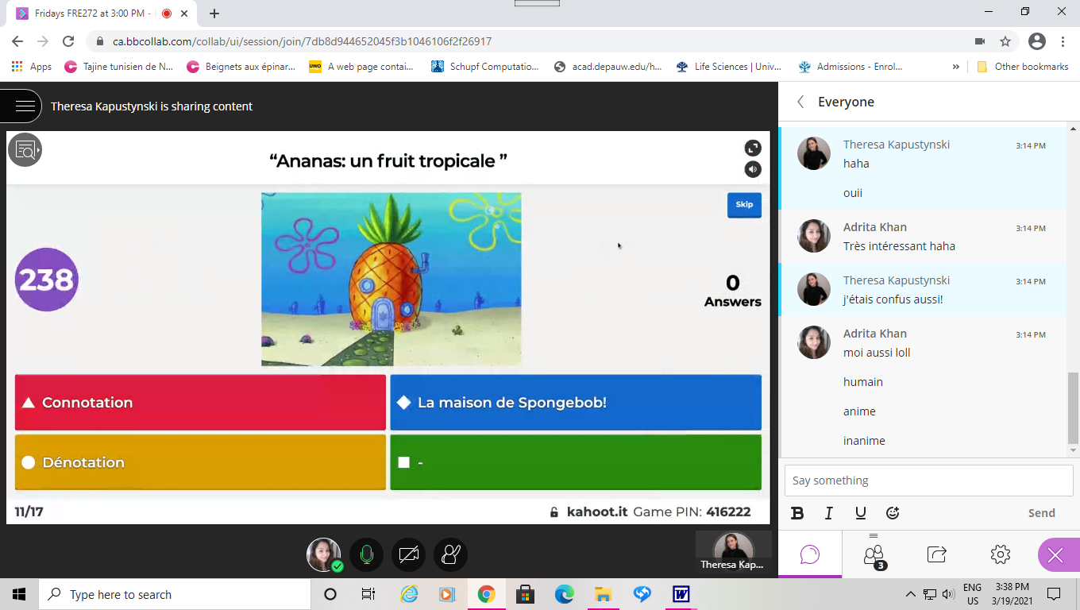
Memes & Kahoot
Notes:
The students loved the memes as they assisted in remembering many concepts
they also liked Kahoot for MC questions.

Slide 15
There is always room for improvement
Tools on BlackBoard Collaborate
More Kahoot!
Other applications (PowerPoint Slides)
Websites (H5P Studio, Padlet, Google Forms)
Notes:
Some ways I could have done better was by using different applications. For the strategic plan goals, I will be working on my MCAT and to start a fundraiser after this is semester.

Slide 16
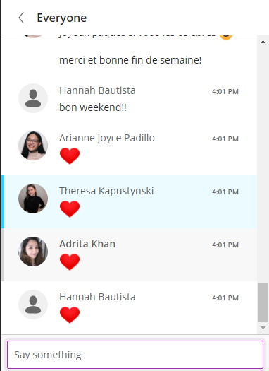
“I am because you are!”
Notes:
Through this rewarding experience, I definitely had a feeling of fulfilment by seeing the impact it made on the students. I remember there were some questions that took them about 5 minutes but later only took them a minute to solve because of the constant practice. We also noticed the confidence boost in the shy student where they were less hesitant and more willing to share their answers. When students came back to tell us that “this part helped a lot on the test” it really made me feel satisfied about the work we were doing. I personally developed better communication skills, especially in French. I learned the various ways how you could make technology so useful. Lastly, I looked forward to each and every Friday as I loved seeing how students benefited from what we came up with.

Slide 17
References
Brame, C.J. and Biel, R. (2015). Setting up and facilitating group work: Using cooperative learning groups effectively. Retrieved from http://cft.vanderbilt.edu/guides-sub-pages/setting-up-and-facilitating-group-work-using-cooperative-learning-groups-effectively/.
Elkington, R. (2020). Ancient Wisdom for Ethical Leadership: Ubuntu and the Ethic of Ecosophy. Journal of Leadership Studies, 13(4), 48-52. doi:10.1002/jls.21672
Husain, Z. (2013) Effective communication brings successful organizational change. Department of Business Administration, Aligarh Muslim University, Aligarh, India
Patrick E. Parrish. (2009). Aesthetic Principles for Instructional Design. Educational Technology Research and Development, 57(4), 511–528. https://doi.org/10.1007/s11423-007-9060-7
Notes:
I want to end it off with: I am because you are! Thank you!

